Slide 1








Lesson 1. Angular 4 Event Binding

Slide 2

Angular4 Event Binding
These bindings flow data in one direction i.e from a component class property to an HTML element property
Interpolation
Property Binding
Attribute Binding
Class Binding
Style Binding
Event binding flows data in the opposite direction i.e from an HTML element to a component
Event Binding alternative syntax (canonical form)

Slide 3
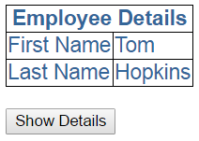
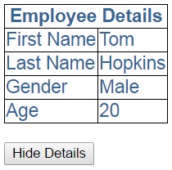
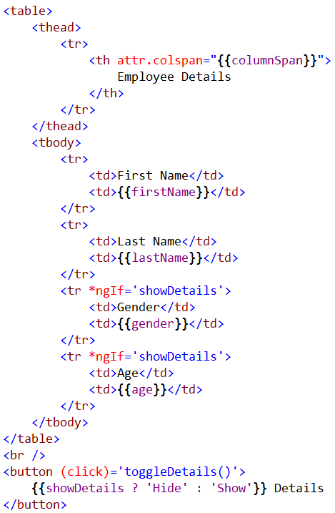
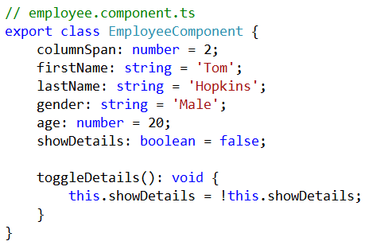
Angular4 Event Binding

Slide 4
Q & A
Contact:rashmipawaskar@synergetics-india.com

Slide 5
Thank You

